Slide 1
Linear Regression
Anshu Pandey

Slide 2
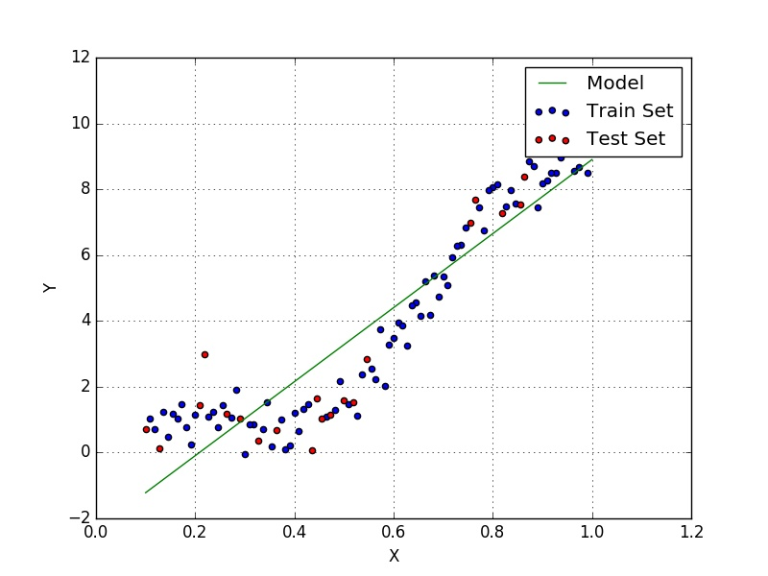
What is Linear Regression?
A Supervised Learning Algorithm that learns from a set of training samples
It estimates relationship between a dependent variable (target/label) and one or more independent variable (predictors).

Slide 3
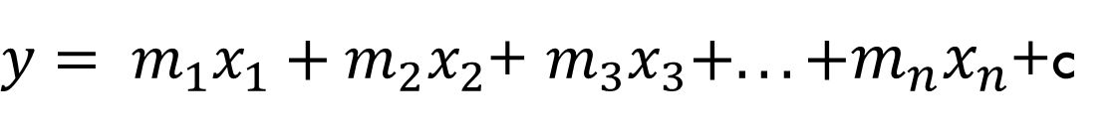
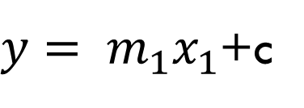
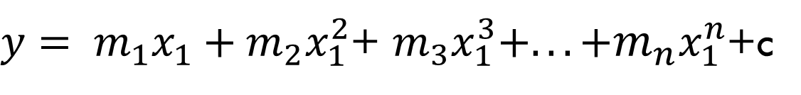
Linear Regression
Univariate Linear Regression
$y= m_{1}x_{1}$+c
Multivariate Linear Regression
$y= m_{1}x_{1}+m_{2}x_{2}$+ $m_{3}x_{3}+.. .+m_{n}x_{n}$+c
Polynomial Linear Regression
$y= m_{1}x_{1}+m_{2}x_{1}^{2}$+ $m_{3}x_{1}^{3}+.. .+m_{n}x_{1}^{n}$+c

Slide 4
Univariate Linear Regression

Slide 5
Univariate Linear Regression
During the training period the regression line is getting more fit.

Slide 6
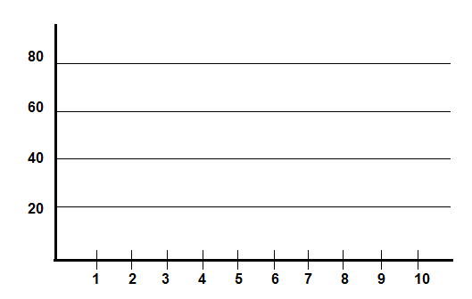
Housing Prices Prediction
Area ( sq ft) | Price In INR
1200 | 20,00,000
1800 | 42,00,000
3200 | 44,00,000
3800 | 25,00,000
4200 | 62,00,000
Price in Lakh (INR)
Area in 1000 sq. feet

Slide 7
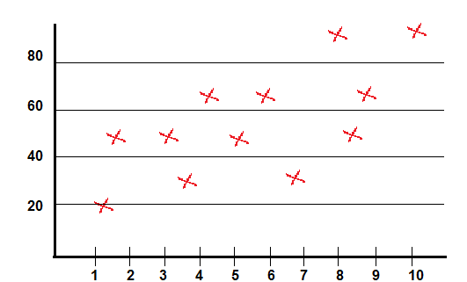
Housing Prices Prediction
y: Dependent Variable, criterion variable, or regressand.
x: Independent variable, predictor variables or regressors.
Area ( sq ft) (x) | Price In INR (y)
1200 | 20,00,000
1800 | 42,00,000
3200 | 44,00,000
3800 | 25,00,000
4200 | 62,00,000
Price in Lakh (INR)
Area in 1000 sq. feet

Slide 8
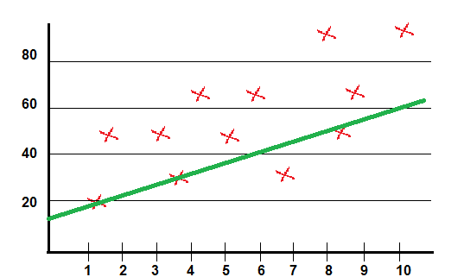
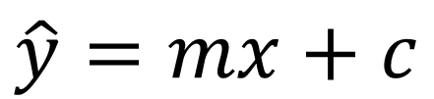
Housing Prices Prediction
$$\hat{y}=mx+c$$
$$\hat{ y}=Value predicted by current Algorithm$$
Linear Regression in one Variable
Area ( sq ft) | Price In INR
1200 | 20,00,000
1800 | 42,00,000
3200 | 44,00,000
3800 | 25,00,000
4200 | 62,00,000
Price in Lakh (INR)
Area in 1000 sq. feet

Slide 9
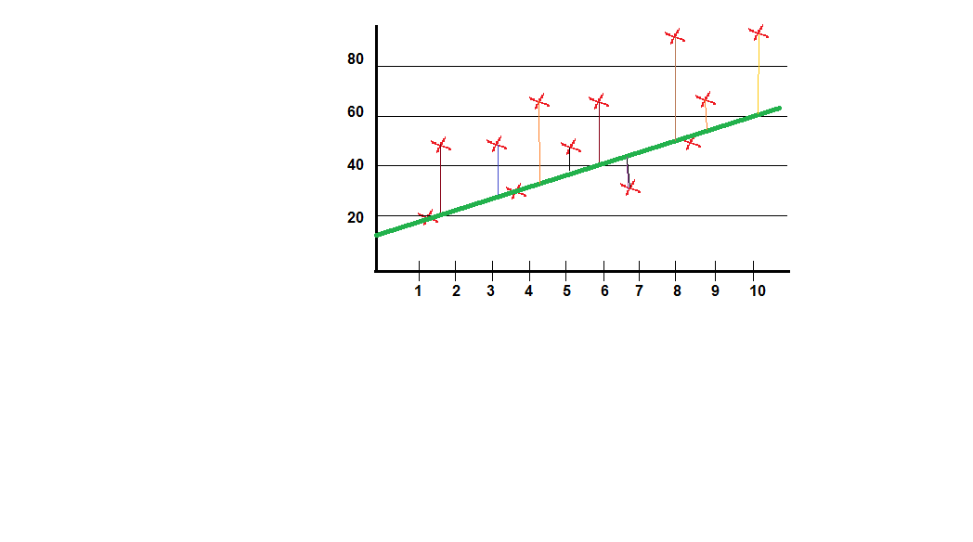

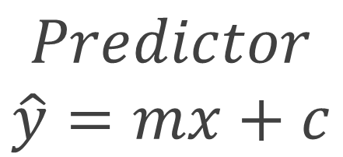


Housing Prices Prediction
$$Predictor$$
$$\hat{y}=mx+c$$
$$y$$
$$\begin{aligned}minimize \\ (y−\hat{y})\end{aligned}$$
$$\hat{y}$$
Price in Lakh (INR)
Area in 1000 sq. feet

Slide 10
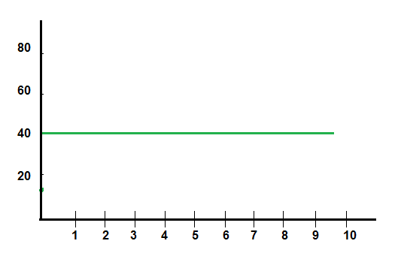
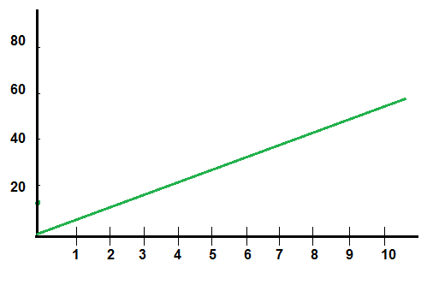
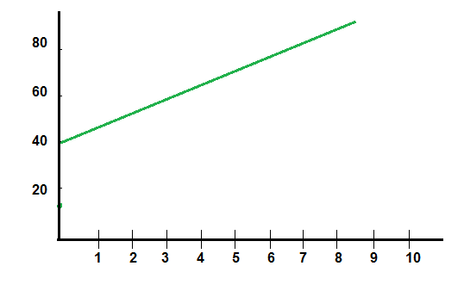
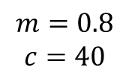
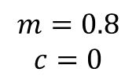
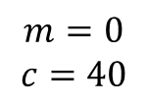
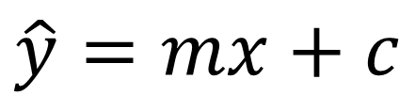
Variables affecting Regression Equation
$$m=0$$
$$c=40$$
$$m=0.8$$
$$c=0$$
$$m=0.8$$
$$c=40$$
$$\hat{y}=mx+c$$

Slide 11

Housing Prices Prediction
$$Predictor$$
$$\hat{y}=mx+c$$
$$\begin{aligned}Cost Function \\ J=\frac{1}{2n}\sum_{i=1}^{n}{{(y_{i}−\hat{y_{i}})}^{2}}\end{aligned}$$
$$j\left(m_{i},c \right)=\frac{1}{2n}\sum_{i=1}^{n}{{(y_{i}−\hat{y_{i}})}^{2}}$$
Price in Lakh (INR)
Area in 1000 sq. feet

Slide 12
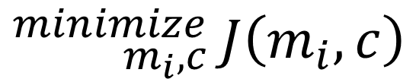
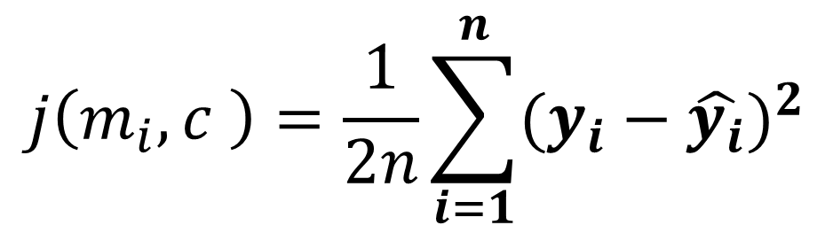
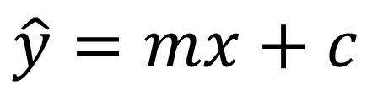
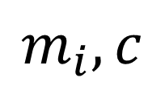
Regression Equation:
$$\hat{y}=mx+c$$
$$m_{i},c$$
Parameters
$$j\left(m_{i},c \right)=\frac{1}{2n}\sum_{i=1}^{n}{{(y_{i}−\hat{y_{i}})}^{2}}$$
Cost Function:
Goal
$${}_{m_{i},c}^{minimize}{ J\left(m_{i},c\right)}$$

Slide 13
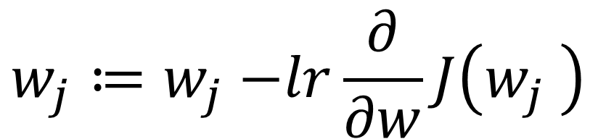

Gradient Descent Algorithm
Repeat Until converge
simultaneously update$,j=0,j=1$
where, w=parameter (coefficient & constant)
$$w_{j}≔w_{j}−lr\frac{∂}{∂w}J\left(w_{j} \right)$$

Slide 14
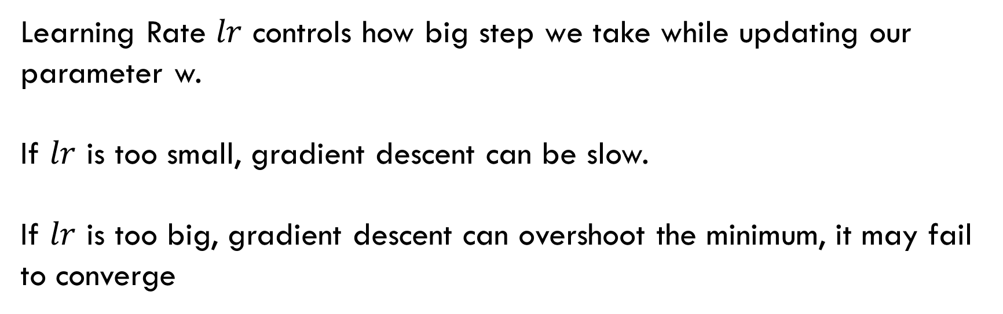

Learning Rate $lr$
Learning Rate $lr$ controls how big step we take while updating our parameter w.
If $lr$ is too small, gradient descent can be slow.
If $lr$ is too big, gradient descent can overshoot the minimum, it may fail to converge

Slide 15
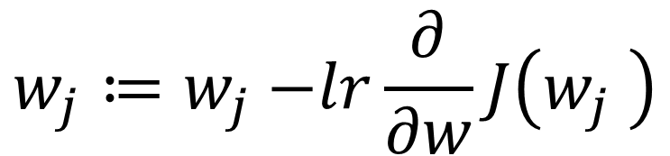

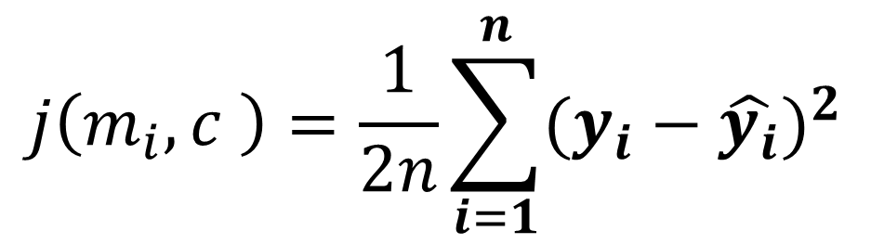
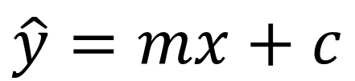
Gradient Descent Algorithm
Linear Regression Model
$$\hat{y}=mx+c$$
Repeat Until converge
simultaneously update$,j=0,j=1$
where, w=parameter (coefficient & constant)
$$w_{j}≔w_{j}−lr\frac{∂}{∂w}J\left(w_{j} \right)$$
$$j\left(m_{i},c \right)=\frac{1}{2n}\sum_{i=1}^{n}{{(y_{i}−\hat{y_{i}})}^{2}}$$

Slide 16
Univariate Linear Regression
Linear Regression Process Visualization

Slide 17
Objective of Linear Regression
Establish If there is a relationship between two variables.
Examples – relationship between housing process and area of house, no of hours of study and the marks obtained, income and spending etc.
Prediction of new possible values
Based on the area of house predicting the house prices in a particular month; based on number of hour studied predicting the possible marks. Sales in next 3months etc.

Slide 18
Linear Regression Use cases
Real Estate
To model residential home prices as a function of the home's living area, bathrooms, number of bedrooms, lot size.
To analyze the effect of a proposed radiation treatment on reducing tumor sizes based on patient attributes such as age or weight.
To predict demand for goods and services. For example, restaurant chains can predict the quantity of food depending on weather.
To predict company’s sales based on previous month’s sales and stock prices of a company.
Medicine
Demand Forecasting
Marketing

Slide 19
Simple Linear Regression
Python code using sklearn

Slide 20
Import the libraries
import numpy
import matplotlib as plt
Import pandas

Slide 21
Import dataset
dataset=pandas.read_csv(‘salary_data.csv’)
X=dataset.iloc[:,:-1].values
Y=dataset.iloc[:,1].values

Slide 22
Import dataset
dataset=pandas.read_csv(‘salary_data.csv’)
X=dataset.iloc[:,:-1].values
Y=dataset.iloc[:,1].values

Slide 23
Train test split
from sklearn.model_selection import train_test_split
xtrain,xtest,ytrain,ytest = train_test_split(X,y,test_size=0.2,random_state=0)

Slide 24
Simple Linear Regression
from sklearn import linear_model
alg = linear_model.LinearRegression()
alg.fit(xtrain,ytrain)

Slide 25
Predicting the test results
ypred=alg.predict(xtest)

Slide 26
Visualizing the training results
plt.scatter(xtrain,ytrain,‘g’)
plt.plot(xtrain,alg.predict(xtrain),’r’)
plt.title(“Training set”)
plt.xlabel(“Experience”)
plt.ylabel(“Salary”)
plt.show()

Slide 27
Visualizing the test results
plt.scatter(xtest,ytest,‘g’)
plt.plot(xtest,alg.predict(xtest),’r’)
plt.title(“Test set”)
plt.xlabel(“Experience”)
plt.ylabel(“Salary”)
plt.show()

Slide 28
Test Score (Accuracy on test data)
accuracy=alg.score(xtest,ytest)
print(accuracy)

Slide 29
Coefficient and intercept value
#for printing coefficient
alg.coef_
# for printing intercept value
alg.intercept_

Slide 30
Performance Analysis
from sklearn.metrics import mean_squared_error, r2_score
# The mean squared error
print("Mean squared error: %.2f"%mean_squared_error(ytest,ypred))
# Explained variance score: 1 is perfect prediction
print('Variance score: %.2f' % r2_score(ytest, ypred))

Slide 31
Multivariate Linear Regression
Python code using sklearn

Slide 32
One Hot Encoding
When some inputs are categories (e.g. gender) rather than numbers (e.g. age) we need to represent the category values as numbers so they can be used in our linear regression equations.

Slide 33
Dummy Variables
Dummy Variables
Salary | Credit Score | Age | State
192,451 | 485 | 42 | New York
118,450 | 754 | 35 | California
258,254 | 658 | 28 | California
200,123 | 755 | 48 | New York
152,485 | 654 | 52 | California
New York | California
1 | 0
0 | 1
0 | 1
1 | 0
0 | 1

Slide 34
Encoding Categorical Data
from sklearn.preprocessing import LabelEncoder
from sklearn.preprocessing import OneHotEncoder
labelencoder = LabelEncoder()
#considering X is dataset from above slide
# 3 is the index number of state
X[:, 3] = labelencoder.fit_transform(X[:, 3])
onehotencoder = OneHotEncoder(categorical_features = [3])
X = onehotencoder.fit_transform(X).toarray()

Slide 35
Avoiding the Dummy variable trap
X=X[:,1:]
NOTE : if you have n dummy variables remove one dummy variable to avoid the dummy variable trap. However the linear regression model that is built in R and Python takes care of this. But there is no harm in removing it by ourselves

Slide 36
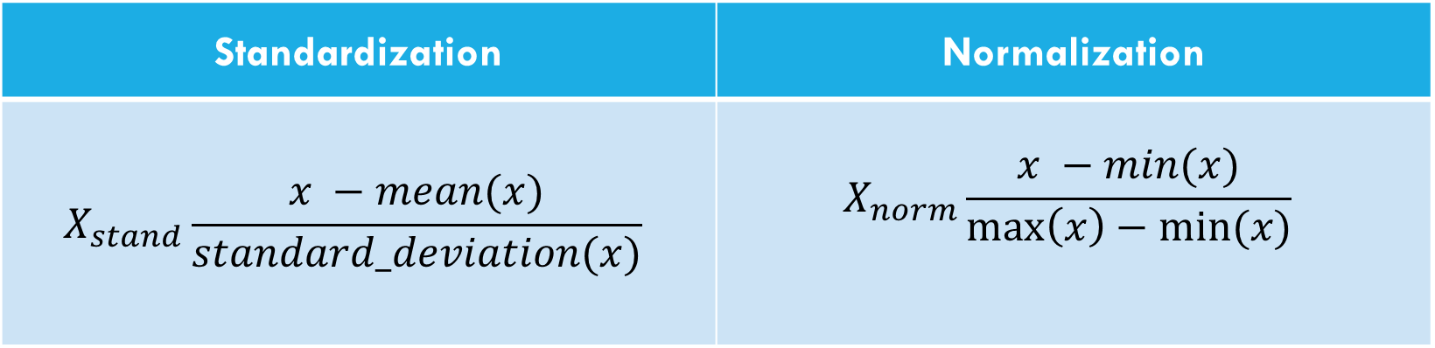
Feature Scaling
Standardization | Normalization
$$X_{stand}\frac{x −mean(x)}{standard_deviation(x)}$$ | $$X_{norm}\frac{x −min(x)}{\max\left(x\right)−min⁡(x)}$$

Slide 37
Standard Scale using sklearn
from sklearn.preprocessing import StandardScaler
sc_x = StandardScaler()
sc_y = StandardScaler()
X_std = sc_x.fit_transform(X)
y_std = sc_y.fit_transform(y)

Slide 38
Boston housing data
In [1]: boston = pd.read_csv('boston.csv’)
In [2]: print(boston.head()
CRIM ZN INDUS CHAS NX RM AGE DIS RAD TAX \
0 0.00632 18.0 2.31 0 0.538 6.575 65.2 4.0900 1 296.0
1 0.02731 0.0 7.07 0 0.469 6.421 78.9 4.9671 2 242.0
2 0.02729 0.0 7.07 0 0.469 7.185 61.1 4.9671 2 242.0
3 0.03237 0.0 2.18 0 0.458 6.998 45.8 6.0622 3 222.0
4 0.06905 0.0 2.18 0 0.458 7.147 54.2 6.0622 3 222.0
PTRATIO B LSTAT MEDV
0 15.3 396.90 4.98 24.0
1 17.8 396.90 9.14 21.6
2 17.8 392.83 4.03 34.7
3 18.7 394.63 2.94 33.4
4 18.7 396.90 5.33 36.2

Slide 39
Creating feature and target arrays
In [3]: X = boston.drop('MEDV', axis=1).values
In [4]: y = boston['MEDV'].values

Slide 40
Predicting house value from a single feature
In [5]: X_rooms = X[:,5]
In [6]: type(X_rooms), type(y)
Out[6]: (numpy.ndarray, numpy.ndarray)
In [7]: y = y.reshape(-1, 1)
In [8]: X_rooms = X_rooms.reshape(-1, 1)

Slide 41
Plotting house value vs. number of rooms
In [9]: plt.scatter(X_rooms, y)
In [10]: plt.ylabel('Value of house /1000 ($)’)
In [11]: plt.xlabel('Number of rooms’)
In [12]: plt.show()

Slide 42
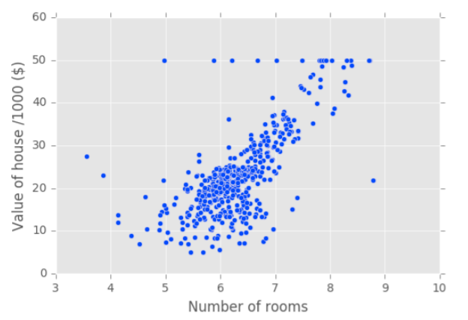
Plotting house value vs. number of rooms

Slide 43
Fitting a regression model
In [13]: from numpy import linspace
In [14]: from sklearn import linear_model
In [15]: alg = linear_model.LinearRegression()
In [16]: alg.fit(X_rooms, y)
In [17]: k=linspace(min(X_rooms),max(X_rooms)).reshape(-1,1)
In [18]: plt.scatter(X_rooms, y, color='blue’)
In [19]: plt.plot(k, alg.predict(k),'b', linewidth=3)
In [20]: plt.show()

Slide 44
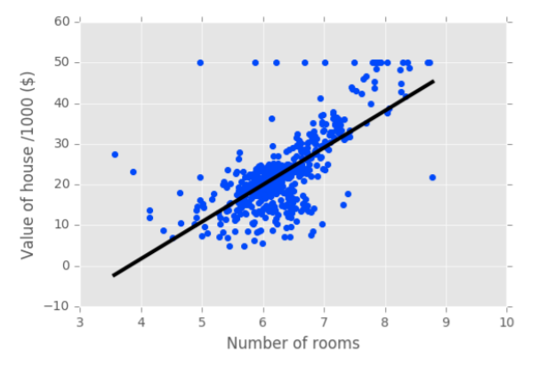
Fitting a regression model

Slide 45
Linear regression on all features
In [1]: from sklearn.model_selection import train_test_split
In [2]: X_train, X_test, y_train, y_test = train_test_split(X, y,test_size = 0.3, random_state=42)
In [3]: alg2 = linear_model.LinearRegression()
In [4]: alg2.fit(X_train, y_train)
In [5]: y_pred = alg2.predict(X_test)
In [6]: alg2.score(X_test, y_test)
Out[6]: 0.71122600574849526

Slide 46
Cross Validation
Split 1
Split 2
Split 3
Split 4
Split 5
Fold 1 | Fold 2 | Fold 3 | Fold 4 | Fold 5
Fold 1 | Fold 2 | Fold 3 | Fold 4 | Fold 5
Fold 1 | Fold 2 | Fold 3 | Fold 4 | Fold 5
Fold 1 | Fold 2 | Fold 3 | Fold 4 | Fold 5
Fold 1 | Fold 2 | Fold 3 | Fold 4 | Fold 5
Metric 1
Metric 2
Metric 3
Metric 4
Metric 5
Training Set
Test Set

Slide 47
Cross-validation and model performance
5 folds = 5-fold CV
10 folds = 10-fold CV
k folds = k-fold CV
More folds = More computationally expensive

Slide 48
Cross-validation in scikit-learn
In [1]: from sklearn.model_selection import cross_val_score
In [2]: alg = linear_model.LinearRegression()
In [3]: cv_results = cross_val_score(alg, X, y, cv=5)
In [4]: print(cv_results)
[ 0.63919994 0.71386698 0.58702344 0.07923081 -0.25294154]
In [5]: numpy.mean(cv_results)
Out[5]: 0.35327592439587058

Slide 49
Overfitting & Generalisation
As we train our model with more and more data the it may start to ﬁt the training data more and more accurately, but become worse at handling test data that we feed to it later.
This is known as “over-ﬁtting” and results in an increased generalization error.
Large coefficients lead to overfitting
Penalizing large coefficients: Regularization

Slide 50
How to minimize?
To minimize the generalization error we should
Collect as much sample data as possible.
Use a random subset of our sample data for training.
Use the remaining sample data to test how well our model copes with data it was not trained with.

Slide 51
L1 Regularisation (Lasso) (Least Absolute Shrinkage and Selection Operator)
Having a large number of samples (n) with respect to the number of dimensionality (d) increases the quality of our model.
One way to reduce the eﬀective number of dimensions is to use those that most contribute to the signal and ignore those that mostly act as noise.
L1 regularization achieves this by adding a penalty that results in the weight for the dimensions that act as noise becoming 0.
L1 regularisation encourages a sparse vector of weights in which few are non-zero and many are zero.

Slide 52
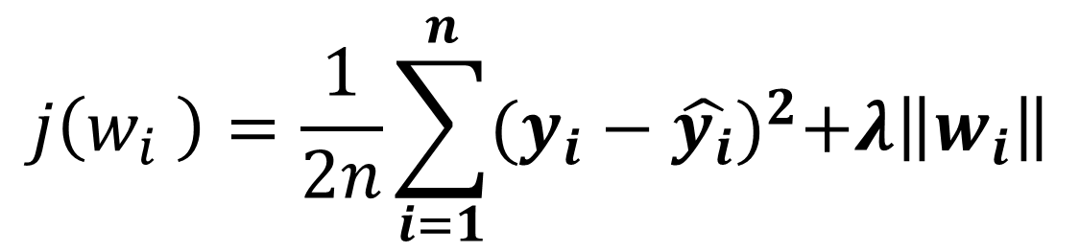
L1 Regularisation (Lasso)
Depending on the regularization strength, certain weights can become zero, which makes the LASSO also useful as a supervised feature selection technique:
A limitation of the LASSO is that it selects at most n variables if m > n.
$$j\left(w_{i} \right)=\frac{1}{2n}\sum_{i=1}^{n}{{(y_{i}−\hat{y_{i}})}^{2}+λ\left\|w_{i}\right\|}$$

Slide 53
Lasso regression in scikit-learn
In [1]: from sklearn.linear_model import Lasso
In [2]: X_train, X_test, y_train, y_test = train_test_split(X, y,test_size = 0.3, random_state=42)
In [3]: lasso = Lasso(alpha=0.1, normalize=True)
In [4]: lasso.fit(X_train, y_train)
In [5]: lasso_pred = lasso.predict(X_test)
In [6]: lasso.score(X_test, y_test)
Out[6]: 0.59502295353285506

Slide 54
L2 Regularisation (Ridge)
Another way to reduce the complexity of our model and prevent overﬁtting to outliers is L2 regression, which is also known as ridge regression.
In L2 Regularization we introduce an additional term to the cost function that has the eﬀect of penalizing large weights and thereby minimizing this skew.

Slide 55
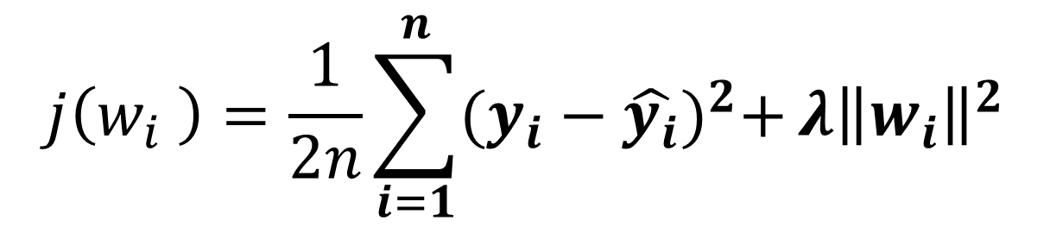
L2 Regularisation (Ridge)
Ridge regression is an L2 penalized model where we simply add the squared sum of the weights to our least-squares cost function:
By increasing the value of the hyperparameter λ , we increase the regularization strength and shrink the weights of our model.
$$j\left(w_{i} \right)=\frac{1}{2n}\sum_{i=1}^{n}{{(y_{i}−\hat{y_{i}})}^{2}+}λ{\left\|w_{i}\right\|}^{2}$$

Slide 56
Ridge regression in scikit-learn
In [1]: from sklearn.linear_model import Ridge
In [2]: X_train, X_test, y_train, y_test = train_test_split(X, y,test_size = 0.3, random_state=42)
In [3]: ridge = Ridge(alpha=0.1, normalize=True)
In [4]: ridge.fit(X_train, y_train)
In [5]: ridge_pred = ridge.predict(X_test)
In [6]: ridge.score(X_test, y_test)
Out[6]: 0.69969382751273179

Slide 57
L1 & L2 Regularisation (Elastic Net)
• L1 Regularisation minimises the impact of dimensions that have low weights and are thus largely “noise”.
• L2 Regularisation minimise the impacts of outliers in our training data.
• L1 & L2 Regularisation can be used together and the combination is referred to as Elastic Net regularisation.
• Because the diﬀerential of the error function contains the sigmoid which has no inverse, we cannot solve for w and must use gradient descent.

Slide 58
Lasso regression for feature selection
● Can be used to select important features of a dataset
● Shrinks the coefficients of less important features to exactly 0.

Slide 59
Lasso regression for feature selection
In [1]: from sklearn.linear_model import Lasso
In [2]: names = boston.drop('MEDV', axis=1).columns
In [3]: lasso = Lasso(alpha=0.1)
In [4]: lasso_coef = lasso.fit(X, y).coef_
In [5]: plt.plot(range(len(names)), lasso_coef)
In [6]: plt.xticks(range(len(names)), names, rotation=60)
In [7]: plt.ylabel('Coefficients')
In [8]: plt.show()

Slide 60
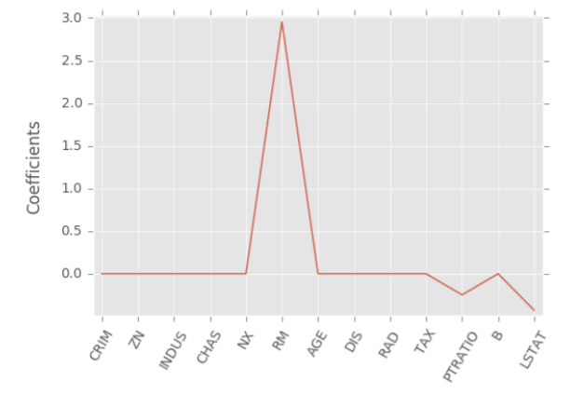
Lasso regression for feature selection

Slide 61
Practice Datasets
https://openmv.net/info/unlimited-time-test
https://openmv.net/info/distillation-tower
https://openmv.net/info/oil-company-doe
http://www.stat.ufl.edu/~winner/datasets.html

Slide 62
Thank you
Stay tuned for practicing Linear Regression with datasets

